Slide 1

AUTO INSURANCE CUSTOMER
ANALYSIS OF AN AUTO-INSURANCE CUSTOMERS USING K-MEANS CLUSTERING
BY RISIKAT AND VIVIAN

Slide 2

TABLE OF CONTENTS
01
02
03
Industry Overview/ Summary
Business Problem
Project and Data assumptions
04
05
06
Data Modeling
Customers Profiles
Recommendation
K-Means Clustering
Using Clustering attributes.
Conclusion

Slide 3

Insurance companies’ rivalry has become more intense over
the years, Customer retention and acquisition are critical for
maintaining a competitive advantage in the industry.

Slide 4
BUSINESS PROBLEM

Slide 5
The problem
Auto Insurance rate evasion is a growing problem in different countries . Rate evasion is providing wrong information in order to obtain cheaper insurance rate. In Canada, Aviva Canada, an insurance company reported that their data shows 9.1% address misrepresentation claims and almost 7% national address misrepresentation claims. Misrepresentation is when wrong home address is provided to get cheaper rates.

Slide 6

Project Assumptions

Slide 7
Assumptions
The datasets we used for this project is correct and meets all quality standards including method of data collection
The property and casualty insurance sector is willing to adjust premium calculation methods as a result of the outcome of this project
Our model accurately captures all categories of insurance customers.
Available dataset is similar to what is obtainable in the Canadian Auto Insurance industry and as a result, the model is reproducible in the aforementioned industry.

Slide 8
Data Modeling: K-means

Slide 9
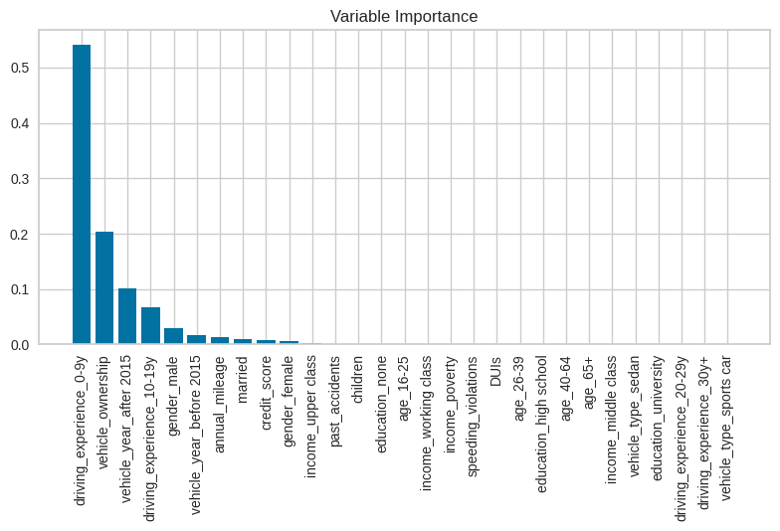
Important Variables based on Decision Tree
Vehicle ownership
Vehicle year
Driving experience
Gender
Annual Mileage
Credit score
Relationship status
K – Means clustering is an algorithm that groups dataset into “K” number of clusters.
To get the optimal number of clusters, the Elbow Curve Method will be applied first. The Elbow Curve method is used to determine the optimal number of clusters to achieve the best result.

Slide 10
K – means Clustering
K – Means clustering is an algorithm that groups dataset into “K” number of clusters.
To get the optimal number of clusters, the Elbow Curve Method will be applied first. The Elbow Curve method is used to determine the optimal number of clusters to achieve the best result.

Slide 11
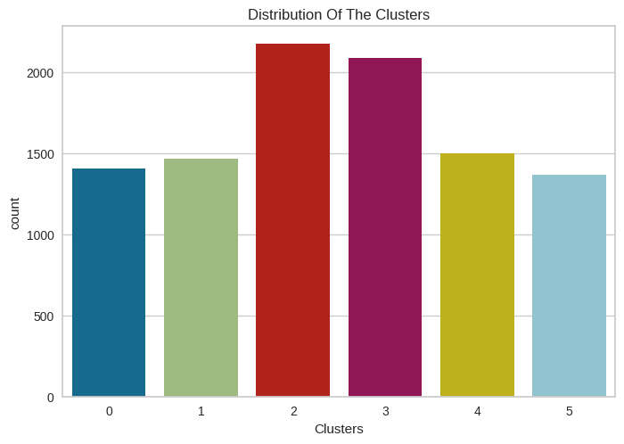
CLUSTER DISTRIBUTION $ COUNT
More customers fall in Cluster 2 and 3. Cluster 5 has the least number of customers.

Slide 12
Customer profiles and risk level

Slide 13
CLUSTER ATTRIBUTES DISTRIBUTION
Cobalt Customers
Filed the most claims in the past year.
High vehicle annual mileage
Green Customers
Filed the least claims among the clusters.
Red Customers
Relatively low claims filed in the past year
Magenta Customer
Lime Customers
Blue Customers
Most of the customers have 0-9 years driving experience.
Relatively high mileage
Driving experience between 10-19 years.
Driving experience between 10-29 years
High Mileage
10-19 years driving experience.
Average mileage
Low claims filed compared to other clusters
Drivers with varying driving experience. 0-9, 10-19, 20-29 and 30y+
Relatively high mileage
Low claims filed
Mostly new drivers, 0-9 years.
Relatively high claims filed.
Higher vehicle mileage

Slide 14
CLUSTER ATTRIBUTES DISTRIBUTION
Cobalt Customers
High risk Customers
Green Customers
Low risk Customers
Red Customers
Medium risk Customers
Magenta Customer
Lime Customers
Blue Customers
Medium risk Customers
Low risk customers
High risk Customers
From the Clustering result, Cobalt and Blue Customers have low driving experience compared to other clusters but has filed the most claims. High vehicle mileage which impacts the overall condition of the car and performance.
Red and Magenta Customers are considered medium risk customers, have more driving experience which means more experience behind the wheel- mitigate road risks and are considered “safe”. The customers in this cluster also filed low claims.
Green and Lime Customers are considered low risk, experienced drivers with the least claims filed among the clusters.

Slide 15
Recommendations
Implement the model in the auto insurance industry for a more equitable auto-insurance pricing.
One of the identified challenges in the analysis was the data. The industry should invest in quality data collection and reporting for future work and modelling.
Other clustering techniques can be developed to support non spherical data modelling.

Slide 16
Conclusion
To summarize the key points in the project:
The Business Problem
Customer’s dissatisfaction with Premium calculations
Project justification and modelling
Recommendations

Slide 17

THANKS!
Do you have any questions?

